Slide 1


Essential Skills and Attributes
              What are they?
              Why are they important to me?
              How can I develop them?
July 2021
Developing Essential Skills and Attributes through Family and Adult Learning

Slide 2
What are Skills?
A skill is the ability to perform an action.
There are lots of different words for skills and approaches
Employability Skills Key Skills Enterprise Skills Life Skills
Foundation Skills 21st Century Skills Basic Skills
Transferrable Skills Soft Skills Core Skills
but they can be categorised into three main types………..

Slide 3
Basic Skills:
literacy and numeracy, and basic digital skills.
Vocational /Technical Skills:
Specific to a particular sector or role and are not easily transferred beyond the sector or role e.g. bricklaying, data analysis.
Essential Skills:
Highly transferable skills that everyone needs in everyday life and to do any job
Can be applied to a wide range of different situations at work and in life i.e. portable

Slide 4
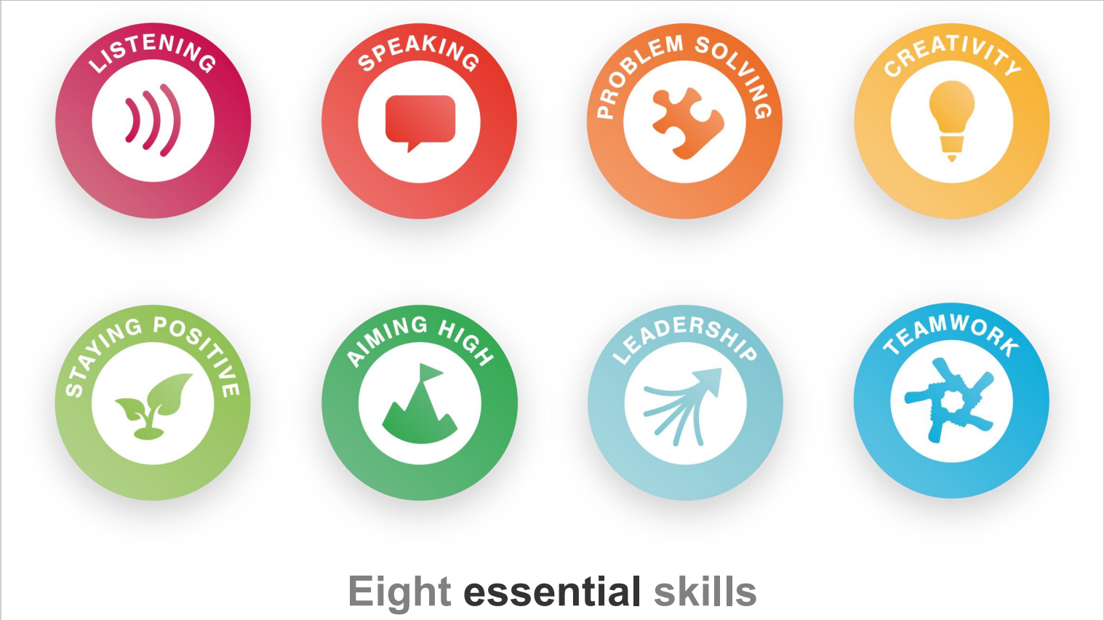
Essential Transferrable Skills
Everyone needs them to succeed - whatever their path in life
The Skills Builder Partnership* - have broken them down into eight critical areas
These are also what employers regard as the most important skills when recruiting their staff
Notes:
*Taskforce including CIPD, CBI, Business in the Community, the Gatsby Foundation, the Careers & Enterprise Company, NCS and the EY Foundation,

Slide 6
What are attributes?
Attributes are qualities that you have naturally.
They are part of your character and shape your behaviour e.g. adaptability, honesty.
A skill can be taught but your attributes cannot, but you can definitely develop them.
The four key attributes most valued in our area are:-
Confidence Tolerance Independence Resilience

Slide 7
Confidence
- being certain of your abilities or having trust in people, plans, or the future
- willingness to accept behaviour and beliefs that are different from your
own, although you might not agree with or approve of them
- being able to do things for yourself and make your own decisions,
without help or influence from other people
- being able to recover quickly from difficulties
Tolerance
Independence
Resilience

Slide 8
Essential skills and attributes - Why Important?
  Essential Skills are valuable for any job, no matter the sector
  Lack of experience isn’t always a barrier to getting a job
  Employers look for potential i.e. people who can demonstrate a good set of transferable skills
  You can show your potential in an interview by demonstrating your essential skills
Your mix of skills helps you to show your flexibility and stand out from the crowd
You already have these skills – you’ve developed them to some extent throughout your life, at school, at home and in your social life, as well as through any experience in the workplace.

Slide 9
How you can develop your skills and attributes
You will be developing them even more on your course, together with your course skills.
This won’t create any extra work other than identifying when you are working on them.
Your tutor will guide you, starting with a short self assessment to help you monitor your progress.
You will be pleasantly surprised, following your course you’ll discover that you have more skills than you think!
Developing Essential Skills and Attributes through Family and Adult Learning

Slide 10

Essential Transferrable Skills
4 Themes | 8 Skills | Development Examples
Communication | Listening | Listen and evaluate other perspectives
 | Speaking | Speak clearly in a discussion. Present info to a group
Creative Problem Solving | Problem solving | Complete tasks. Explore problems and solutions. Implement plans/ actions
 | Creativity | Develop creative and innovative ideas
Interpersonal skills | Leadership | Encourage others to contribute effectively to shared goal
 | Teamwork | Take part in an activity involving shared goals
Self- Management Skills | Staying Positive | Keep trying and look for opportunities when things go wrong
 | Aiming High | Set goals and stick at achieving them

Slide 11
Essential Skills and Attributes
You now know more about:
What they are
Why they are important
How you can develop them on your course
A final word …
“..... we focus on hiring people with essential transferable skills – team players who can pitch in and help others in all sorts of situations. It’s important never to underestimate the power of versatility.” Richard Branson (2021)

