Slide 1



Skills and Employment Course Induction

Slide 2

Induction Outline
your learning entitlement
the Individual Learning Plan (ILP)
progress and support beyond your course
Health and Safety and Safeguarding
Equality and Diversity
course improvement and feedback
Learner Handbook
Induction Checklist in the Individual Learning Plan

Slide 3
Your Learning Entitlement
the role of your tutor
policies can be viewed at www2.cheshireadultlearning.org

Slide 4
the funding for your course
Skills and Employment contacts:
    - tutor
    - Programme Manager, benjamin.watts@cheshirewestandchester.gov.uk
    - Skills and Employment Manager, matthew.smith@cheshirewestandchester.gov.uk
  Code of Conduct and ground rules

Slide 5
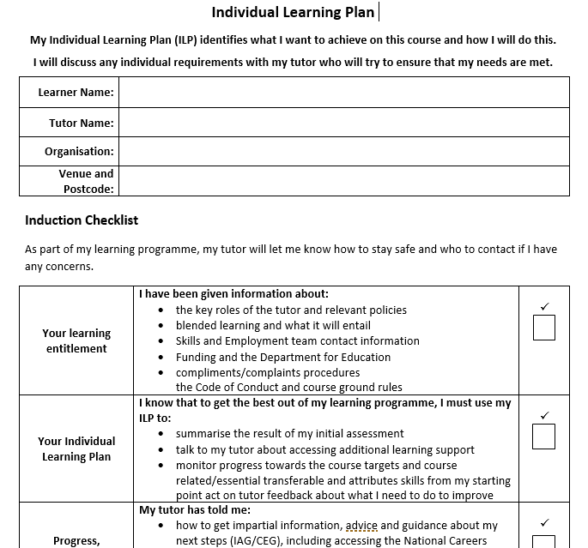
The Individual Learning Plan (ILP)
summary of initial assessment
opportunities to access additional learning support
course targets and personal targets
course related/essential transferable skills and attributes

Slide 6

The
Individual Learning Plan (continued)
monitoring of progress from starting point
  Tasks
  Questions and answers
  Group work and discussions
  Quizzes
  Observations
tutor feedback about how to improve
learner feedback

Slide 7
Essential (Transferable) Skills and Attributes
During the course, you will develop many of the following transferable skills/aptitudes:
Essential Skills | Meaning
Listening | The receiving, retaining and processing of information or ideas
Speaking | The oral transmission of information or ideas
Problem Solving | The ability to find a solution to a situation or challenge
Creativity | The use of imagination and the generation of new ideas
Staying Positive | The ability to use tactics and strategies to overcome setbacks and achieve goals
Aiming High | The ability to set clear, tangible goals and devise a robust route to achieving them
Leadership | Supporting, encouraging and developing others to achieve a shared goal
Teamwork | Working cooperatively with others towards achieving a shared goal
Attributes | Meaning
Resilience | The capacity to recover quickly from difficulties and toughness
Confidence | The quality of being certain of your abilities or of having trust in people, plans, or the future
Independence | Being able to do things for yourself and make your own decisions, without help or influence from other people
Tolerance | Willingness to accept behaviour and beliefs that are different from your own, although you might not agree with or approve of them

Slide 8

Progress, Careers, Learning and IAG/CEG
free and impartial Information, Advice and Guidance (IAG), about potential next steps:
  Further learning
  Employment - Careers Education and Guidance (CEG)
  Both further learning and employment
plans for the future and signposting for support if required
tutors will not give advice about things they aren’t sure about
examples of help available includes:
  National Careers Service
  Employment mentors
  Housing
  Benefits support
  Local colleges
  other adult learning providers

Slide 9


Slide 10
Personal Development (PD)
  Personal Development (PD), including maths, English, digital skills, plus other essential skills and aptitudes
  Maths – Times tables, maps, lists
  Digital Skills – Virtual learning, researching on smart devices
  English – Group discussions, learning new words

Slide 11
Health and Safety
Housekeeping
The following housekeeping arrangements relating to your venue are important to know:
emergency evacuation procedures
location of fire exits
toilets
other Health and Safety considerations
smoking policy
refreshment facilities

Slide 12

5 Ways to Health & Wellbeing
Connect
Spend time with the people around you,
family, friends, colleagues, neighbours, at work and local communities
Be Active
Walk, dance, exercise, but remember,
good quality sleep is every bit as important to wellbeing as being active
Take Notice
Be aware of the world around you and of your own feelings.
Notice the beautiful and enjoy the moment
Give
Give your time by doing something nice for a friend or stranger.
Give someone a compliment. Join a group and contribute
Keep Learning
Try something new.
Learning new things will help you feel more confident as well as being fun

Slide 13

Safeguarding
Disclosing concerns:
  Tutor
  Safeguarding Lead
  Matthew Smith on 07990 532 840 or at matthew.smith@cheshirewestandchester.gov.uk
  Safeguarding designated officers:
  Ben Watts on 07881 500 226 or at benjamin.watts@cheshirewestandchester.gov.uk
  Jodie Ronan on 07768 558 858 or at
  jodie.ronan@cheshirewestandchester.gov.uk

Slide 14

Safeguarding
British Values
British Values |  | Definition | How to promote and apply the values
M | Mutual respect and tolerance | Equality and fairness for all regardless of their background or religious beliefs | Engage in activities and events such as Black History Month, International Women’s Day, etc Have an open minded and liberal attitude to those whose faith and beliefs may defer from your own Show respect for an individual’s dignity
I | Individual Liberty | Freedom, for example the right to believe and express oneself in a manner of one’s own choosing within the law | Make your own decision about the programme you would like to study Raise understanding and tackle prejudice so all are treated with respect and in line with the Equality duty Promote benefits of diversity Celebrate the individuality of your peers and staff
L | The rule of Law | Laws protect everyone, no-one is above the law | Abide to group rules and the Learner Code of Conduct Vicky to think of something
D | Democracy | People power - freedom to express opinions and a willingness to listen to other views | Express your opinion during group discussions and activities Have your view on what you think works best for you Provide honest feedback about your learning experience
What are they?
MILD
M
Mutual respect and tolerance
I
Individual Liberty
L
The rule of Law
D
Democracy

Slide 15
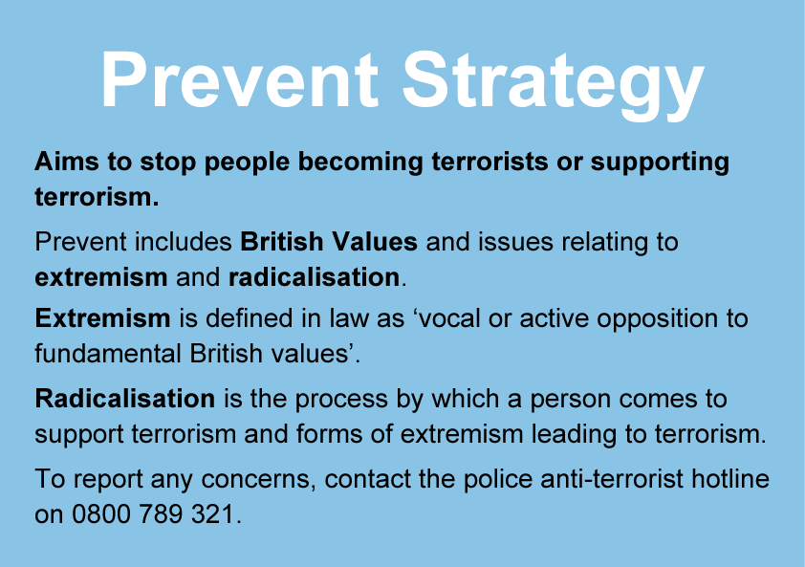
Safeguarding
PREVENT
suspicious behaviours
trust your instincts and report
reporting concerns could save lives
www.gov.uk/ACT
Contact the Anti-terrorist hotline in confidence on
0800 789321
In an emergency, dial 999

Slide 16

Working Safely Online
These basic measures will ensure you are safe whilst working online.
Personal Information – keep this private.
Chat rooms and messaging may form part of the course delivery. Don’t post inappropriate or offensive comments
Keep your password secure and ensure you log off when you leave your computer
Reject any unwanted online requests for contacts/friends
Recordings and screenshots of online sessions must not be taken without permission
Notes:
When working online there are some considerations needed to keep you and other learners safe.
Personal Information – keep this private.
Don’t post information about your address, date of birth, family or health information online.
Chat rooms and messaging may be part of the course delivery. Don’t post inappropriate or offensive comments
These will be monitored by tutors and users are reminded that they must only post appropriate content
Keep your password secure and ensure you log off your computer when you leave
Choose passwords that are difficult for others to guess. Include letters, numbers and symbols to increase their security. Logging off your computer ensures that no one else can access your information even if they are using the same computer. Never tell anyone your password, even if they are on the same course.
Reject any unwanted online requests for contacts/friends
Only accept friend requests from people you know. You can block/refuse requests from people at any time
Recordings and screenshots of online sessions must not be taken without permission
If a session needs to be recorded, this will be done by the tutor who will seek the relevant permissions. Recordings will be stored securely and only shared appropriately.

Slide 17

Working Safely Online
These basic measures will ensure you are safe whilst working online.
Classroom rules still apply online
Offensive or abusive language will not be tolerated during online teaching sessions, in group messages or online chats
Backgrounds should be blurred during online sessions
Limit interruptions
Please refer to our Online Policy and Cyber Bullying Policies for detailed information and guidance. These can be found at Safeguarding – Cheshire West and Chester (cheshireadultlearning.org)
Notes:
Classroom rules still apply
Offensive or abusive language will not be tolerated during online teaching sessions, in group messages or online chats
Backgrounds should be blurred during online sessions
Busy backgrounds are a distraction to others, so best to use the ’blur’ option when in online sessions
Learners must dress appropriately when taking part in online sessions
Even though you might be comfortable at home, you must dress appropriately when taking part in online sessions.

Slide 18
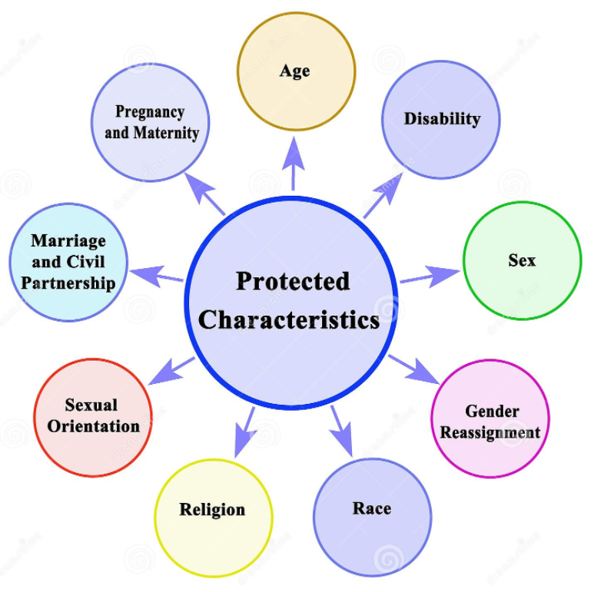
Equality and Diversity
Equality Act 2010 - 9 protected characteristics
https://youtu.be/VXLtKlmtrvM
additional needs, health conditions or illness that can affect wellbeing or attendance
reporting concerns about unfair treatment
  your tutor or,
  Programme Manager, Ben Watts at benjamin.watts@cheshirewestandchester.gov.uk

Slide 19

Course Improvement and Feedback
You can provide us with feedback about the course by:
completing your ILP and end of course learner feedback form
speaking to your tutor
contacting the Programme Manager, Ben Watts, at: benjamin.watts@cheshirewestandchester.gov.uk
leaving feedback online at: https://cheshireadultlearning.org/learner_feedback/new
visiting the Ofsted website at:
https://www.gov.uk/government/organisations/ofsted

